Slide 1
UAV-2
UAV-1
Building
Building
GS

Slide 2
UAV-2
UAV-1
GS

Slide 3
DL UAV-j
UL UAV-i
MBS
FD-GS

Slide 4
UAV-(j+1)
UAV-j
UAV-(j-1)
GS

Slide 5
Uplink UAVs
Inter-UAV Interference
Downlink UAVs
Uplink Transmissions
Downlink Transmissions
Service Area
SI
FD-GS

Slide 6
Multi-Antenna FD Transceiver Configuration
Transmit Antenna
Input Signal
DAC
X
SI
RF
Absorbers
Oscillator
-
-
Signal
Detection
+
+
Passive Domain
+
ADC
+
X
Receive Antenna
Digital Domain
Analog Domain
Single-Antenna FD Transceiver Configuration
Input Signal
DAC
X
SI
Oscillator
Circulator
-
-
Signal
Detection
+
+
ADC
+
+
X
Digital Domain
Analog Domain
Passive Domain

Slide 7
Interference Management Strategies
II Strategy
JD Strategy
Treats interference as noise.
Ideal when interference is weak.
Structure of interference is used to decode desired signal.
Errors from decoding interference is acceptable.
Ideal when interference is sufficiently strong.
SIC Strategy
Successively removes interference before signal detection.
Ideal when interference is strong.
UAV-1
Inter-UAV Interference
UAV-2
Downlink Transmissions
Service Area
FD-GS

Slide 8
Example of SCMA in an HBD-UCS
Time-Frequency Resource Blocks
UAV-1
Codebook-1
UAV-2
Codebook-2
UAV-3
Codebook-3
UAV-4
Codebook-4
UAV-5
Codebook-5
UAV-6
Codebook-6
Inter-UAV Interference
Uplink UAVs
Downlink UAVs
Uplink Transmissions
Downlink Transmissions
Service Area
SI
FD-GS

Slide 9
Example of Power-Domain NOMA in an HBD-UCS
Power Allocation
UAV-1
UAV-3
UAV-5
UAV-2
UAV-6
UAV-4
UAV Index
Inter-UAV Interference
Uplink UAVs
Downlink UAVs
Uplink Transmissions
Downlink Transmissions
Service Area
SI
FD-GS

Slide 10
Rate Region at UAV-2 for the II Strategy
where
UAV-1 Transmission Rate :
FD-GS Transmission Rate :
Interference :
SOI :
Inter-UAV Interference
UAV-1
UAV-2
Downlink Transmissions
Service Area
FD-GS

Slide 11
Rate Region at UAV-2 for the SIC Strategy
where
UAV-1 Transmission Rate :
FD-GS Transmission Rate :
Interference :
SOI :
Inter-UAV Interference
UAV-1
UAV-2
Downlink Transmissions
Service Area
FD-GS

Slide 12
Rate Region at UAV-2 for the JD Strategy
where
UAV-1 Transmission Rate :
FD-GS Transmission Rate :
Interference :
SOI :
Inter-UAV Interference
UAV-1
UAV-2
Downlink Transmissions
Service Area
FD-GS

Slide 13
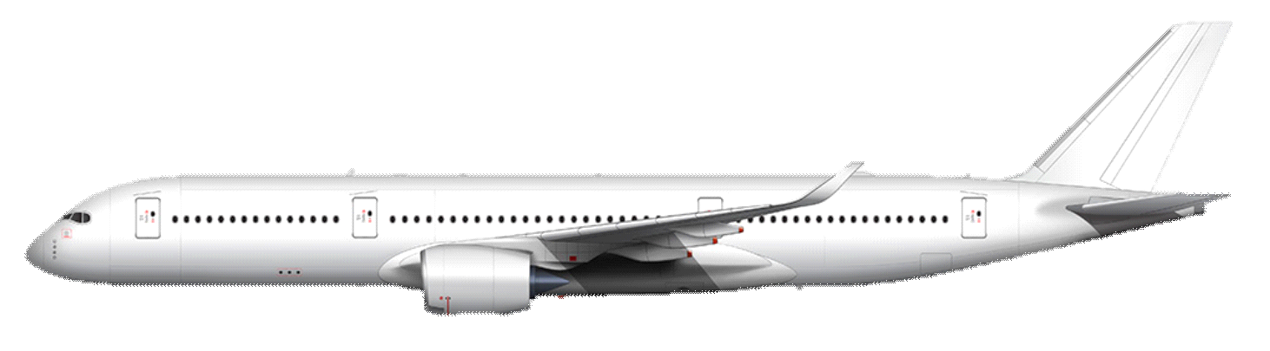
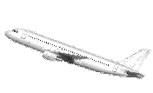
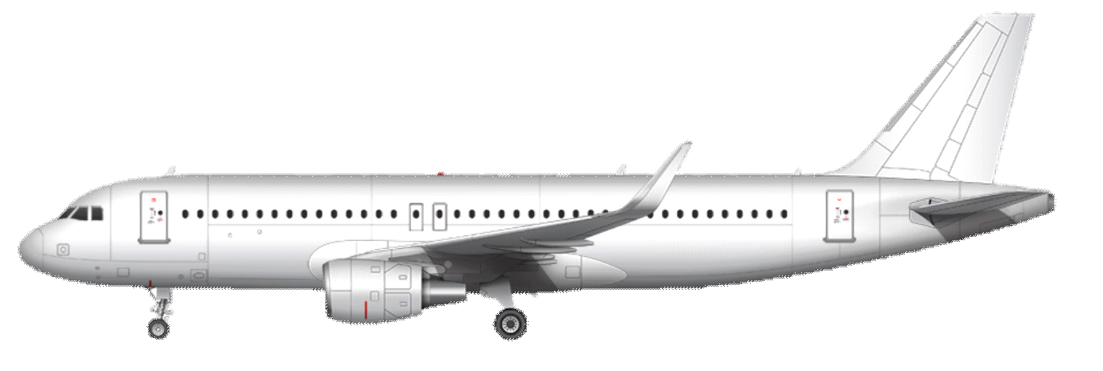
High Altitude
Satellite
Satellite-to-Air Link
Medium Altitude
Air-to-Air Link
Air-to-Ground Link
Low Altitude / Ground Level
Air-to-Ground Link
Airport Link
Airport GS

Slide 14
High Altitude
Satellite
Satellite-to-UAV Link
Medium Altitude
UAV-to-UAV Link
UAV-to-Ground Link
Low Altitude / Ground Level
UAV-to-Ground Link
UAV-to-Ground Link
GS

Slide 15
Section 2.2: UAV Channel Models
Section 2.3: Self-Interference at FD
Ground Stations
Chapter 2: Literature Review
Section 2.4: Inter-UAV Interference
Management Strategies
Section 2.5: Power-Domain
Non-Orthogonal Multiple Access
for HBD UAV Communications

Slide 16
Section 2.2: UAV Channel Models
Log Distance Approach
Stochastic Approach

Slide 17
Section 2.3: Self-Interference at FD Ground Stations
SI Mitigation Architectures
FD Transceiver Impairments
Passive Domain
Phase Noise
Analog Domain
Imperfect SI Channel
Estimation
Digital Domain
Quantization Noise
Combination of Domains
And Other Alternatives

Slide 18
Section 2.4: Inter-UAV Interference
Management Strategies
Interference Management
Strategies
Performance Evaluation
Interference Ignorant
Outage Probability
Successive Interference
Cancellation
Finite SNR Diversity Gain
Joint Detection

Slide 19
Section 2.5: Power-Domain Non-Orthogonal Multiple Access
for HBD UAV Communications
Basic Overview of NOMA
Towards Multi-User
HBD Communications
Code-Domain NOMA
Power-Domain NOMA
Relevance of Power-Domain
NOMA in an HBD-UCS

